Slide 1
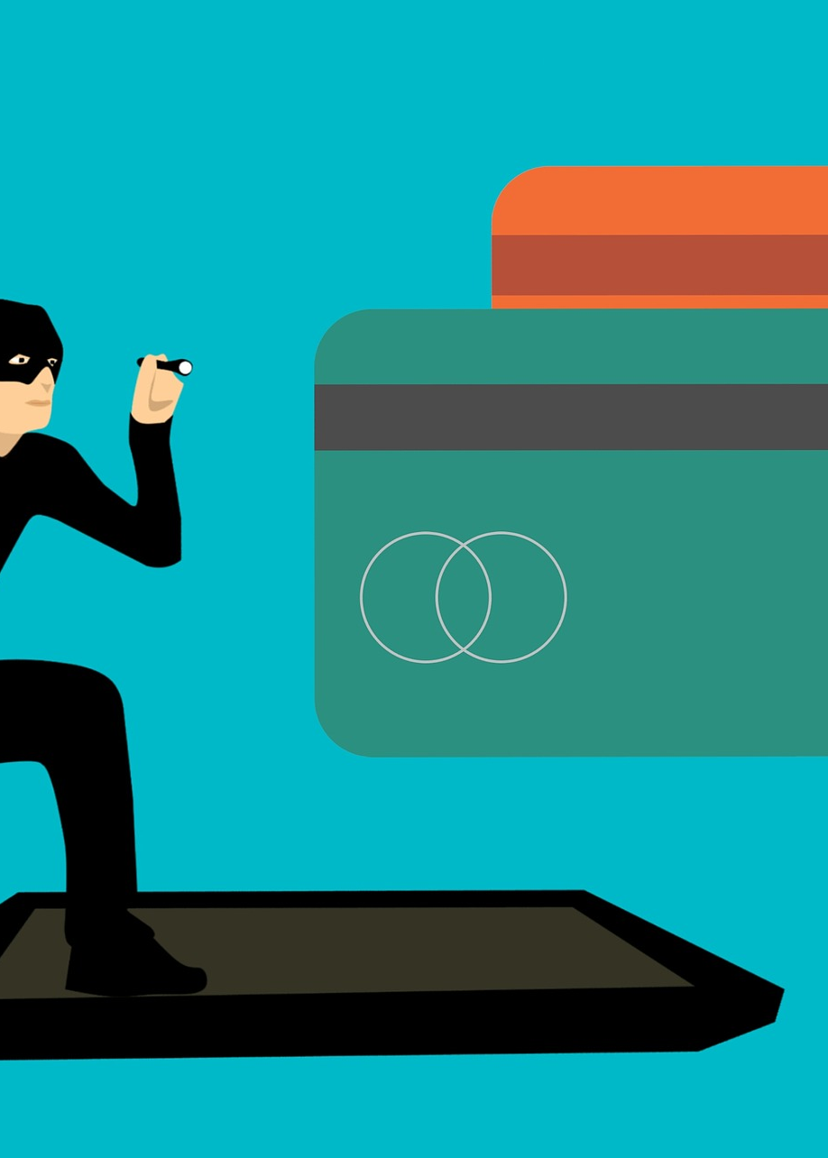
Detecting Anomalies in Credit Card Transactions Using Power BI
Learn how to use Power BI to detect fraudulent credit card transactions quickly, accurately, and easily. Get a detailed overview of the project, understand the dataset, and explore key finding insights.

Slide 2
Introduction
Why is detecting anomalies in credit card transactions important?
Anomalies are often early indicators of fraudulent activity, which is critical to prevent financial loss and protect customers.
What makes credit card fraud detection challenging?
Credit card fraud is constantly evolving, with new tactics and technologies emerging every day.

Slide 3


Background
What is credit card fraud?
It's the unauthorized use of a credit or debit card, or card number, to fraudulently obtain money or goods.
How has data analysis changed the way we detect fraud?
Advanced data analytics tools like Power BI can help us detect patterns in large datasets and identify fraudulent transactions more quickly and accurately.

Slide 4

Objectives
1 Reduce financial loss
By detecting fraudulent transactions more quickly, we can minimize financial loss for both the cardholders and issuers.
2 Protect customers
By detecting fraud early, we can protect customers from the damage and inconvenience that comes with credit card fraud.
3 Improve efficiency
By automating the fraud detection process, we can improve efficiency and reduce the need for manual review.

Slide 5
Overview of Power BI
Key features of Power BI
Powerful data visualization tools, flexible data connectivity options, and built-in AI capabilities.
1
2
3
What is Power BI?
Power BI is a suite of business analytics tools that allows you to analyze data and share insights.
Why use Power BI?
Power BI is user-friendly, fast, and affordable. It's also part of the Microsoft eco-system, which makes it easy to integrate with other Microsoft tools.

Slide 6

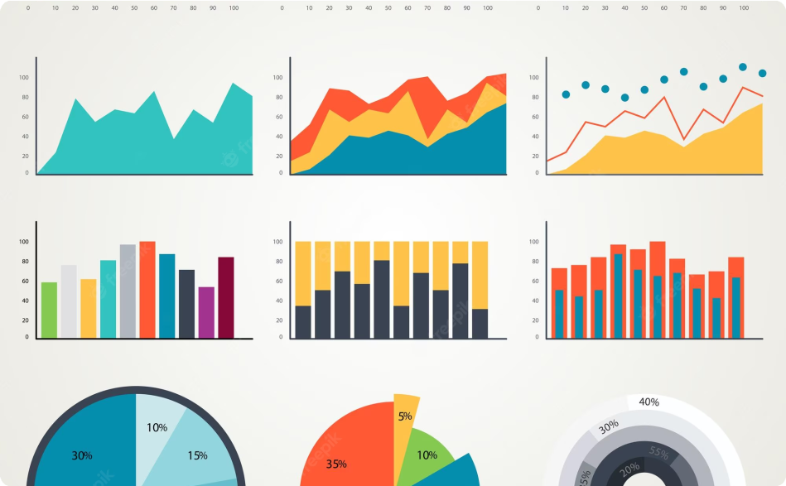
Data Presentation
What is data presentation?
Data presentation is the process of organizing and summarizing data into a visual format that is easy to understand.
Key visualizations for detecting anomalies in credit card transactions
Line charts, scatter plots, and histograms are just a few examples of visualizations that can help identify fraudulent transactions.

Slide 7
Understanding the Dataset
What does the dataset contain?
The dataset contains anonymized information about credit card transactions, including transaction amount, timestamp, location, and more.
What are some common data issues to watch out for?
Missing data, duplicates, and incorrect data types are common data issues that can affect the accuracy of the analysis.

Slide 8
Importing Data into Power BI
1
Step 1: Connect to the data source
Power BI supports a wide range of data sources, including Excel spreadsheets, CSV files, and cloud-based databases.
Step 2: Load the data into Power
BI
Once you've connected to the data source, you can use Power BI to import
the data into the platform.
2
3
Step 3: Transform the data
You can use Power BI to clean, transform, and shape the data to meet your analysis needs.

Slide 9

Data Cleaning and Transformation
1
Why is data cleaning important?
Data cleaning is important because it ensures that the data is accurate, complete, and consistent.
2
What are some common data cleaning and transformation tasks?
Removing duplicates, adjusting data types, and creating calculated columns are some common data cleaning and transformation tasks.

Slide 10
Data Modeling
What is data modeling?
Data modeling is the process of creating a conceptual representation of the data in order to facilitate analysis.
What are some common data modeling techniques?
Star schemas, snowflake schemas, and data mining are some common data modeling techniques used in fraud detection.

Slide 11

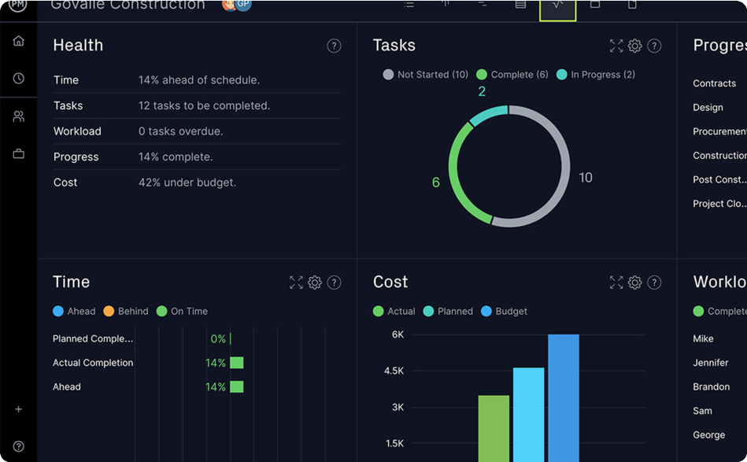
Summary of the Project
What were the results of the project?
The project successfully identified several fraudulent transactions that would have gone undetected using traditional methods.
What did the final dashboard look like?
The final dashboard included several key visualizations and summaries that allowed analysts to quickly identify anomalies in the data.

Slide 12
Key Finding Insights
What were the implications of these findings?
The findings suggest that fraudsters are becoming more sophisticated in their tactics, and that credit card issuers need to be vigilant in order to prevent loss.
1
2
What were the key findings?
The project uncovered several patterns of fraudulent behavior, including transactions made at unusual times or locations, transactions made by new accounts, and transactions with unusual purchase amounts.

Slide 13

Future Enhancements
1 2
What are some potential future enhancements?
Integrating machine learning algorithms, real- time data integration, and expanding the scope of the analysis to include other types of fraud are just a few potential future enhancements.
How can these enhancements help?
These enhancements can help improve the accuracy and efficiency of fraud detection and prevention, while also reducing costs and minimizing financial loss.

